Slide 1
Virtual mobility the pathway to creat an on-line course HERZEGOVINA UNIVERSITY
Online training by Agricultural University in Nitra
6-7 September, 2023

Slide 2
General description of the learning activity
Virtual mobility in CIRCULAR ECONOMY IN KARST AREA course is:
- a regular, one-semester (virtual-blended) course with 5 ECTS, undergraduate (level 6 EQF), at SUSTAINABLE ENVIRONMENT study,
- organizred by Herzegovina University, Department for Ecology and Environmental Protection, with experts included from regional development agency HERDA and UNDP office for B&H,

Slide 3
Topics / Disciplines
Virtual mobility in CIRCULAR ECONOMY IN KARST AREA course is:
- aimed at developing specific competencies in environmental protection, in socially responsible economy and recycling, particularly in regions with predominantly karst terain, folowed by adequate knowledge, skills and routines, together with global perspectives on SDG (Sustainable Development Goals)

Slide 4
Target group
Target groups for virtual mobility in CIRCULAR ECONOMY IN KARST AREA course are:
- primarily undergraduate students of SUSTAINABLE ENVIRONMENT programme,
- the course is also open to researchers, but also to start-up enterpreneurs and SME managers who would like to upgrade their businesses.

Slide 5
Pedagogical approach
The pedagogical approach for virtual mobility in CIRCULAR ECONOMY IN KARST AREA course is:
- online learning with (optional) face-to-face learning,
- collaborative project-based learning (the attendees are obliged to create a small business plan that includes feasible circular economy elements in their communities).
The evaluation is primarily qualitative, it is focused on the project (preparation, structure of the business plan, inclusive approach, etc.) that includes assesment of theoretical fundaments, practical and innovative elements and presentability of the task to change the approach with the wider community).

Slide 6
Tools included (technical aspects)
The tools to deliver CIRCULAR ECONOMY IN KARST AREA virtual course are the following:
- Herzegovina University‘s own Learning Platform (euniversity.ba),
- online sources and databases on CIRCULAR ECONOMY,
- video conferencing tools.
Learning platform include tools for group learning, joint project development, individual learning and tests and assesment sowtfare for qualitative evaluation.

Slide 7
Language
The language to deliver CIRCULAR ECONOMY IN KARST AREA virtual course is:
- English.
Support materials are provided in Croatian.

Slide 8
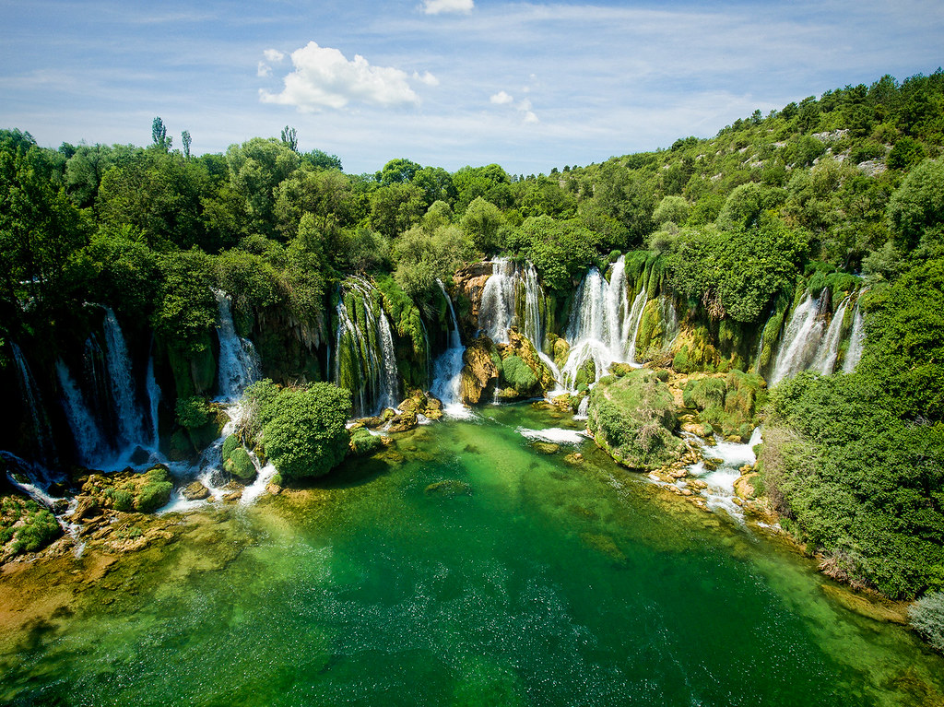
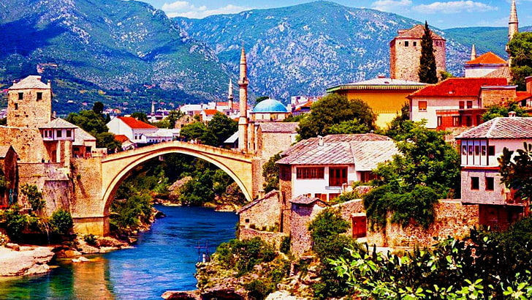
After the virtual course, you are more than welcome to visit us in Mostar, Herzegovina. It is much more pleasant ...

