Slide 1

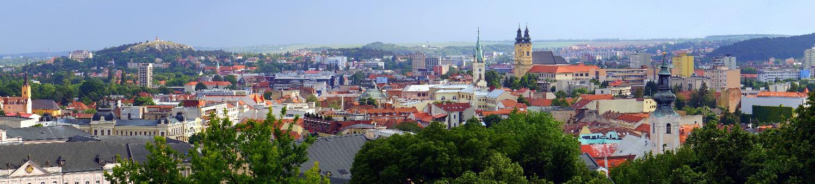
NITRA
GREEN SOLUTIONS

Slide 2
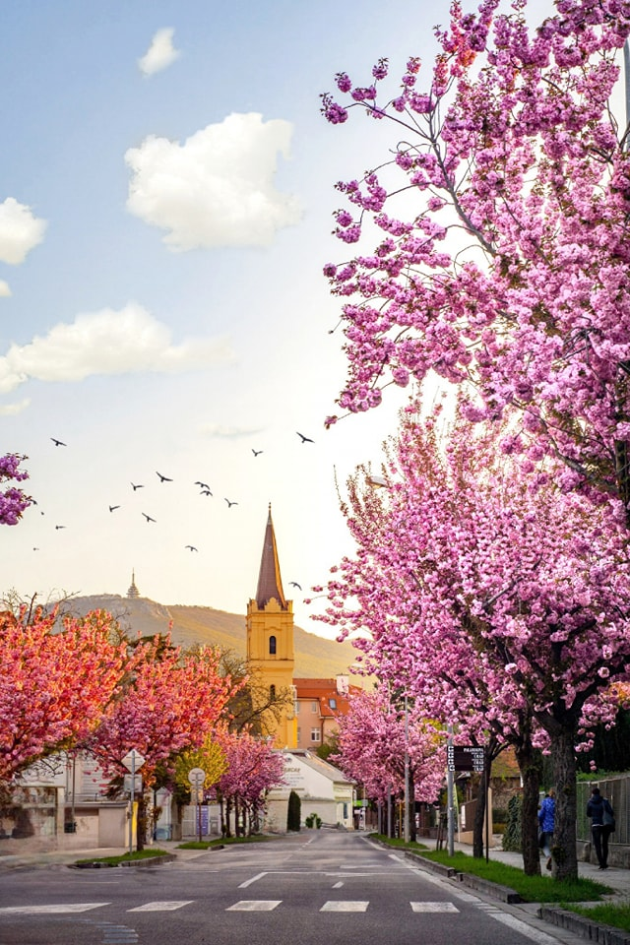
CITY OF NITRA
​COUNTRY: Slovak republic
REGION: Nitra region, Capital city of the region
AREA: 100,48 km2 (38,8 sq. mi)
POPULATION: 76 426
​​CITY OF YOUTH
2 universities and 13,000 university students
CITY OF HISTORY ​
first mention: AD 870 – 871, the oldest town of Slovakia
1 castle, 20 churches, archaeological area​
CITY OF CULTURE
3 theatres, 5 libraries, 5 museums, 2 galleries​
CITY OF EXHIBITOINS
143 ha exhibition area
CITY OF GREENERY ​
140 m2 of urban greenery per capita
CITY OF INDUSTRY
700 ha industrial parks​, 4.08% unemployment rate

Slide 3
DATA MANAGEMENT 2013 - 2023

Slide 4
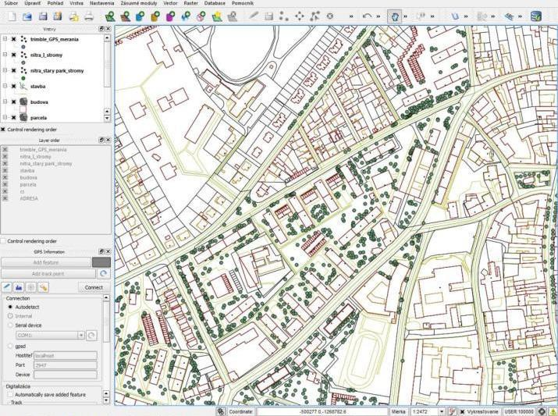
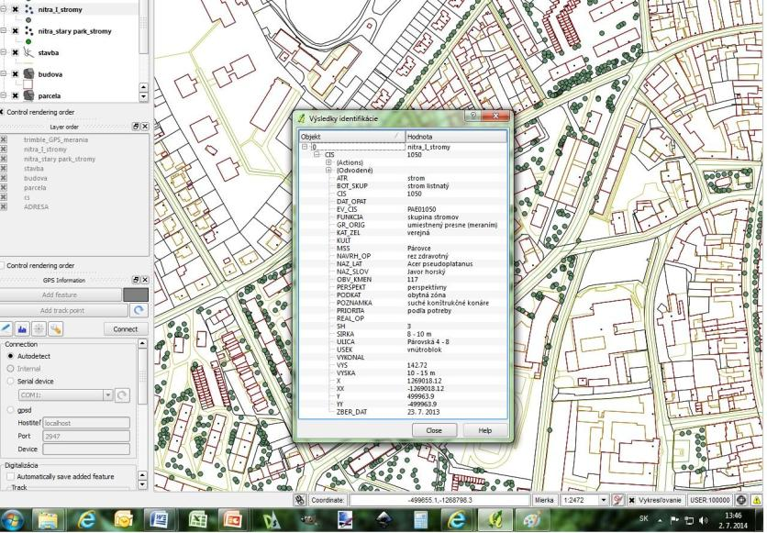
Greenery maintenance plan
Mapping and metronomic of trees
Health condition and perspective
Maintenance proposals
Financial planning of interventions

Slide 5
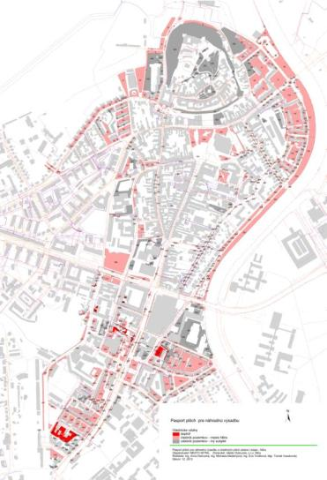
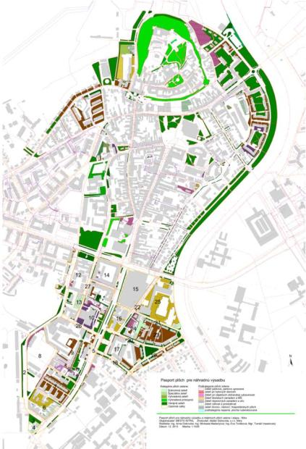
Potential planting plots for greenery in the City
ownership structure
greenery functionality and benefits
spatial reserves for new planting
green areas preservation /no construction permits/

Slide 6
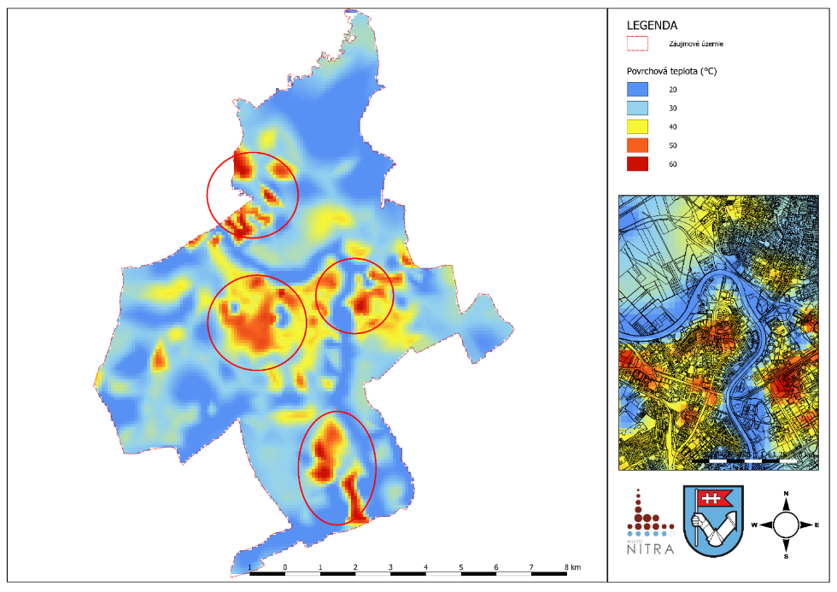
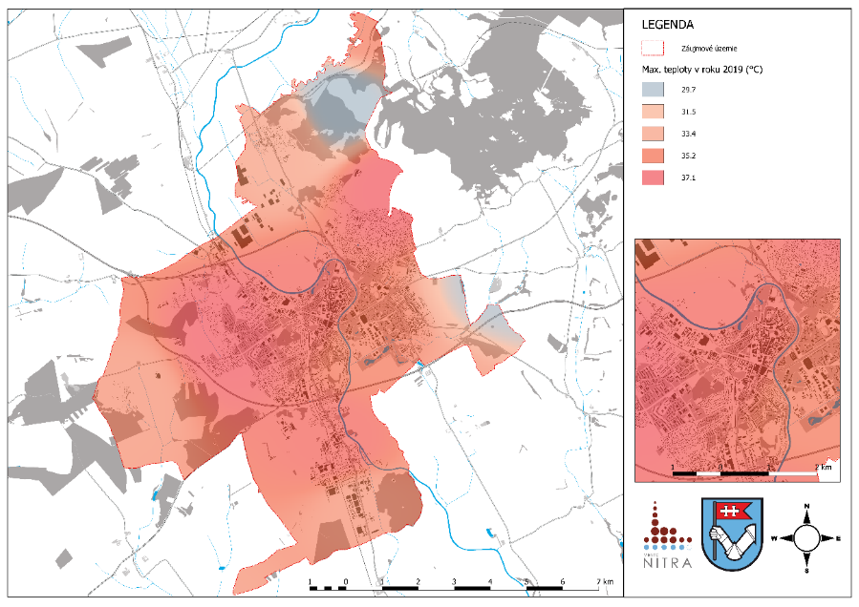
CLIMATE CHANGE MITIGATION PLAN – HEAT ISLANDS / TEMPERATURE AMPLITUDES

Slide 7
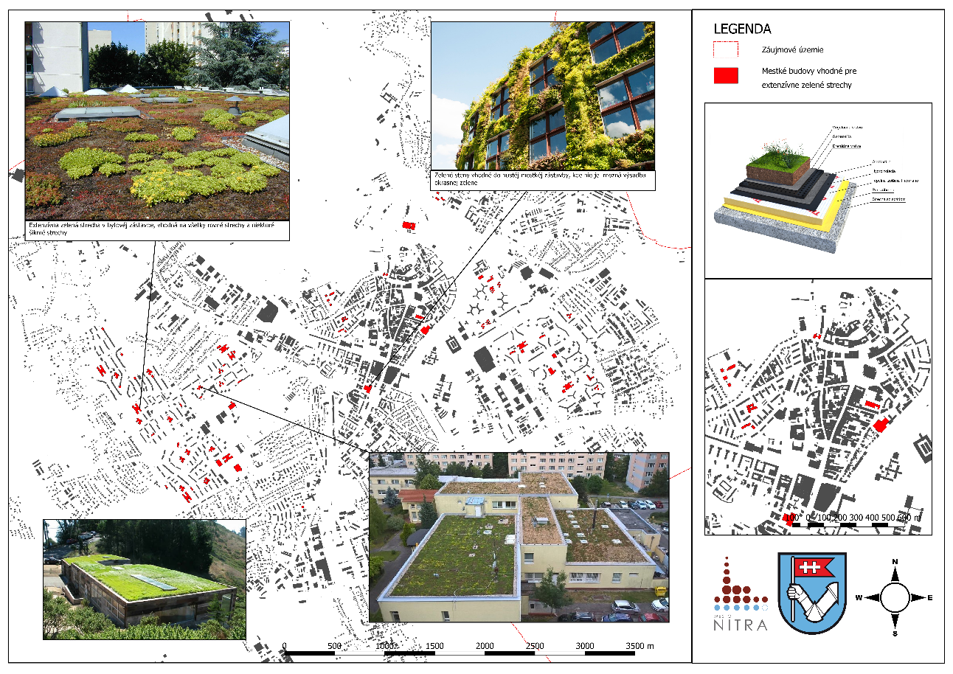
CLIMATE CHANGE MITIGATION PLAN – POTENTIAL GREEN ROOFING AREAS

Slide 8
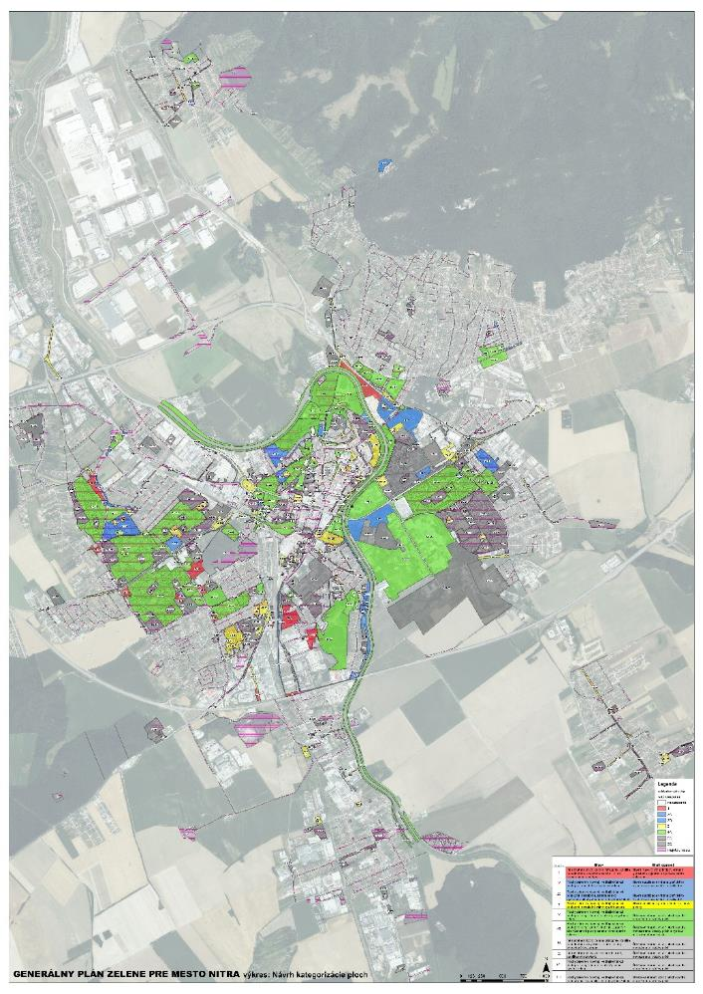
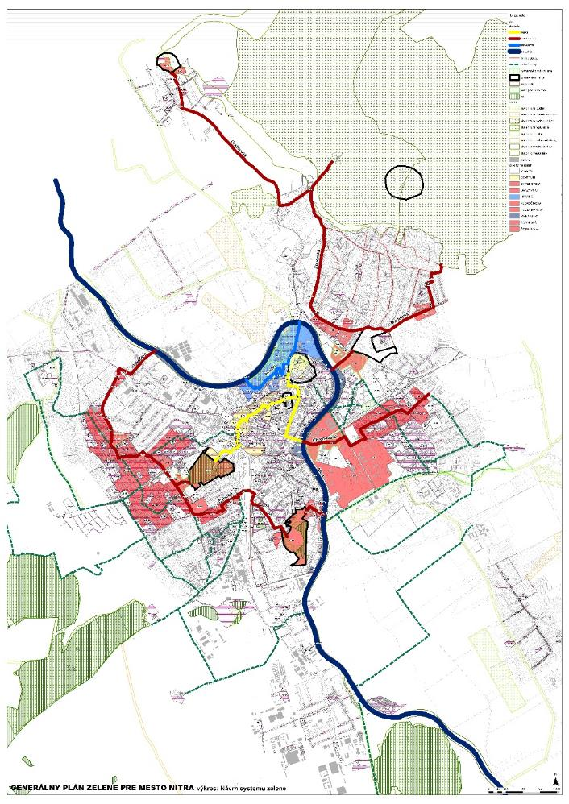
CITY GREENERY GENERAL PLAN – SUPPORT FOR URBAN PLANNING

Slide 9
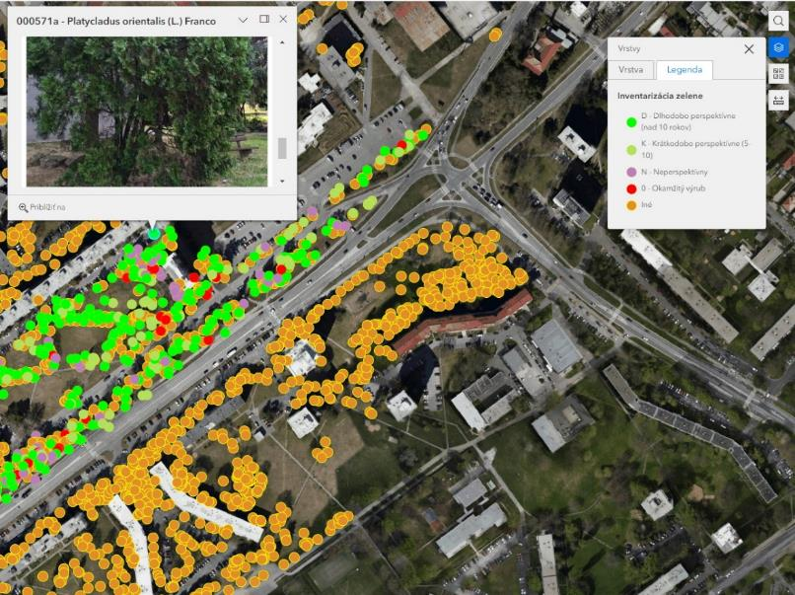
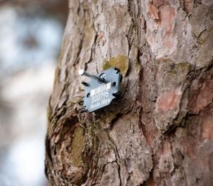
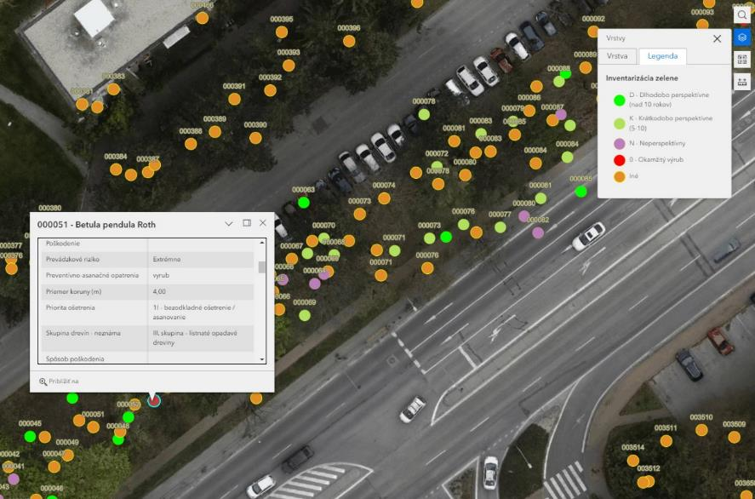
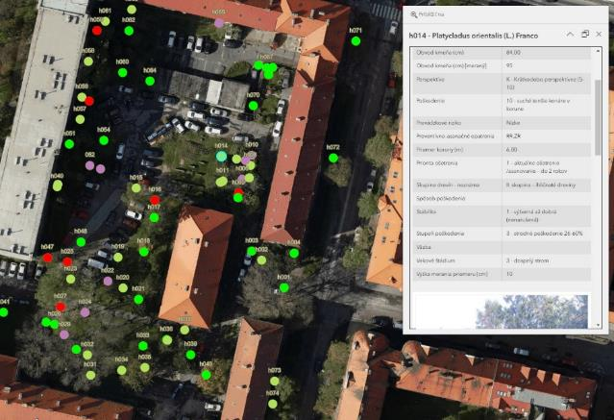
Registry of trees – public greenery
GPS data
Trees safety evaluation
Mobile data collection
Trees get shields with numbers and specific QR code

Slide 10
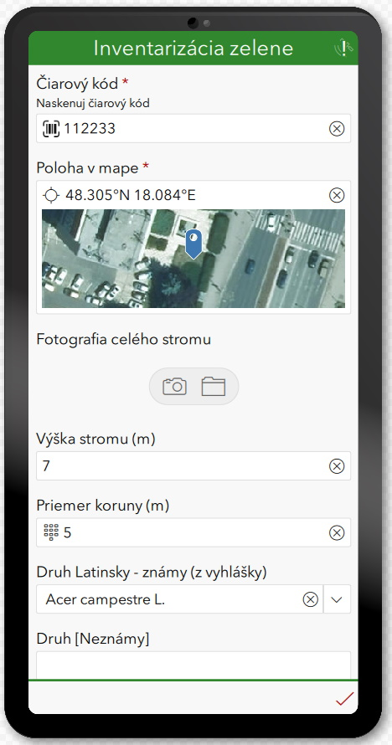
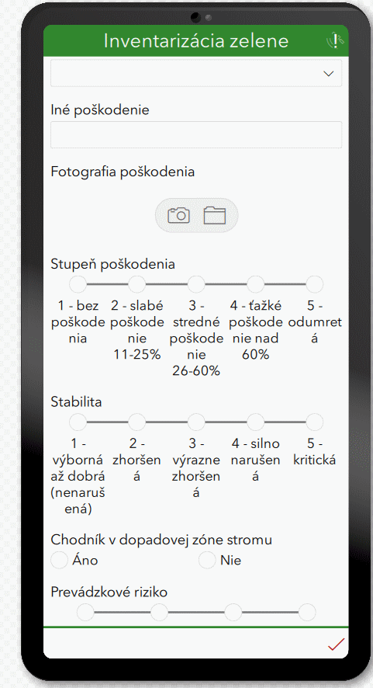
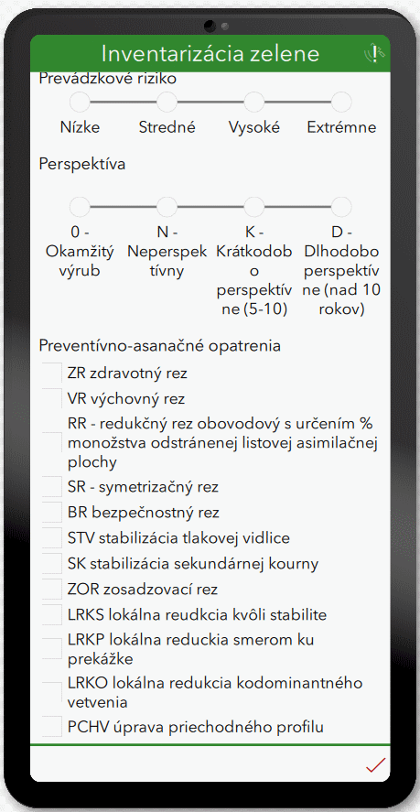

Slide 11
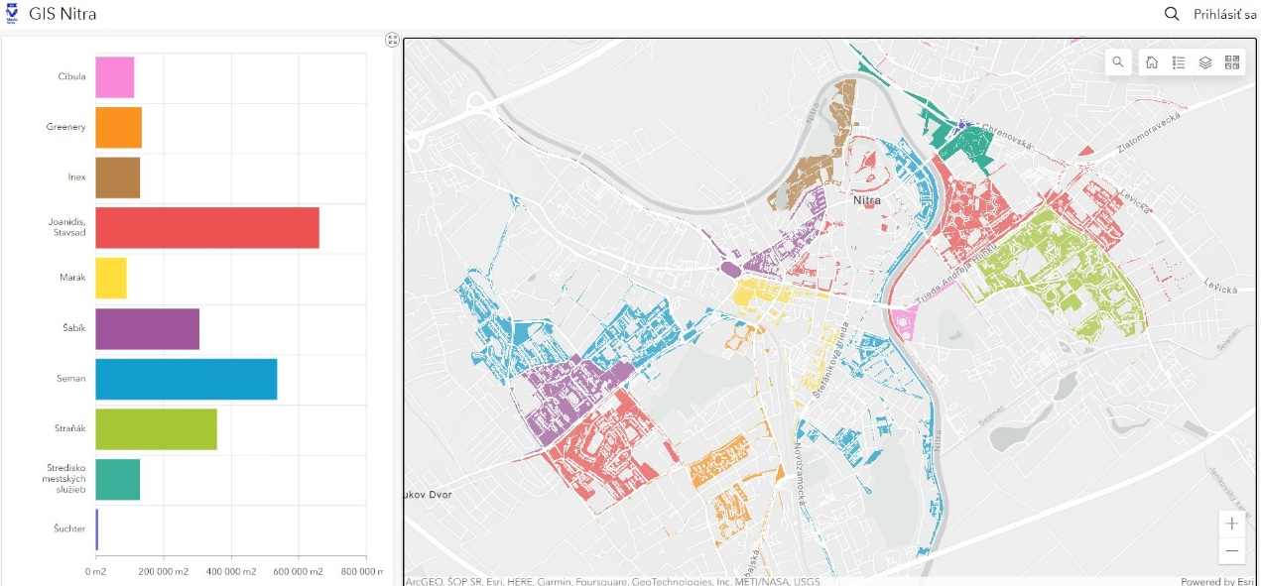
Public greenery – maintanance plan

Slide 12
PLANNING & DESIGN

Slide 13
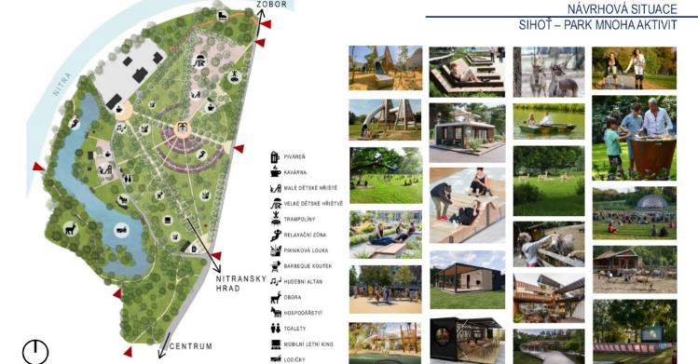
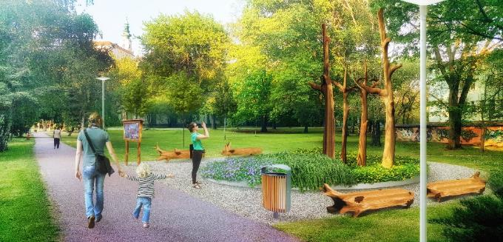
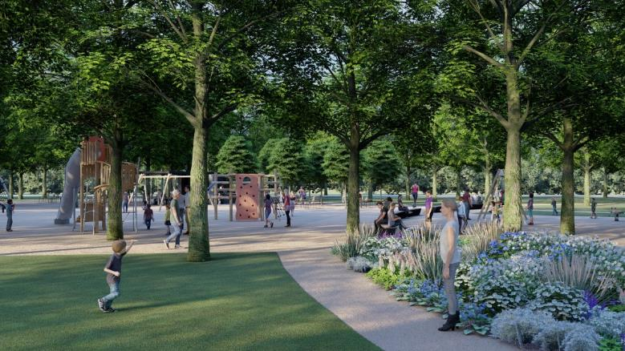
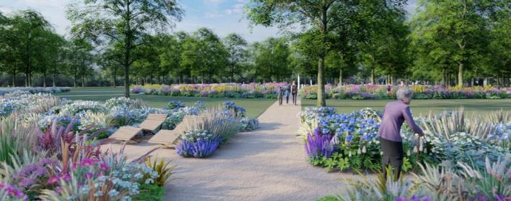
MUNICIPAL PARK /OLD PARK/ 2020

Slide 14
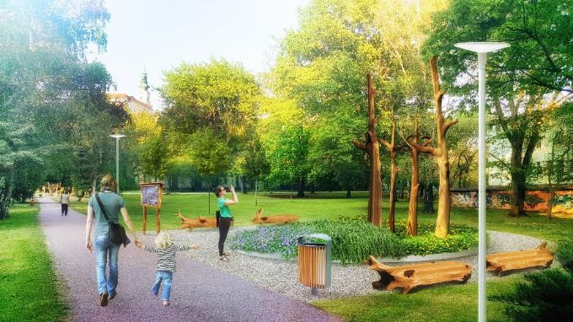
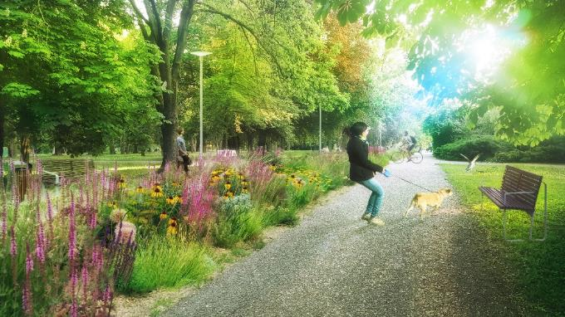
MUNICIPAL PARK /NEW PARK/ 2017

Slide 15
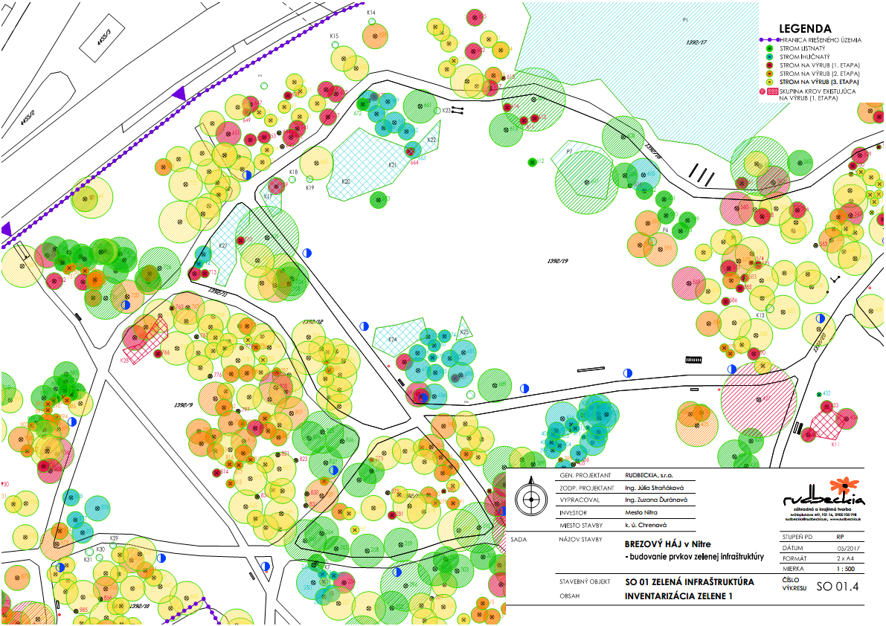
BREZOVÝ HÁJ /2017/

Slide 16
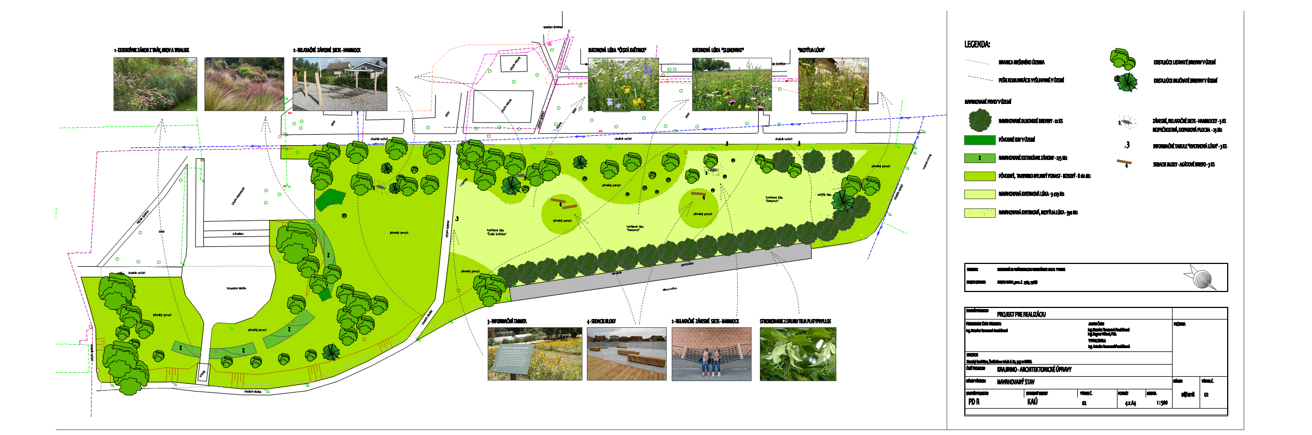
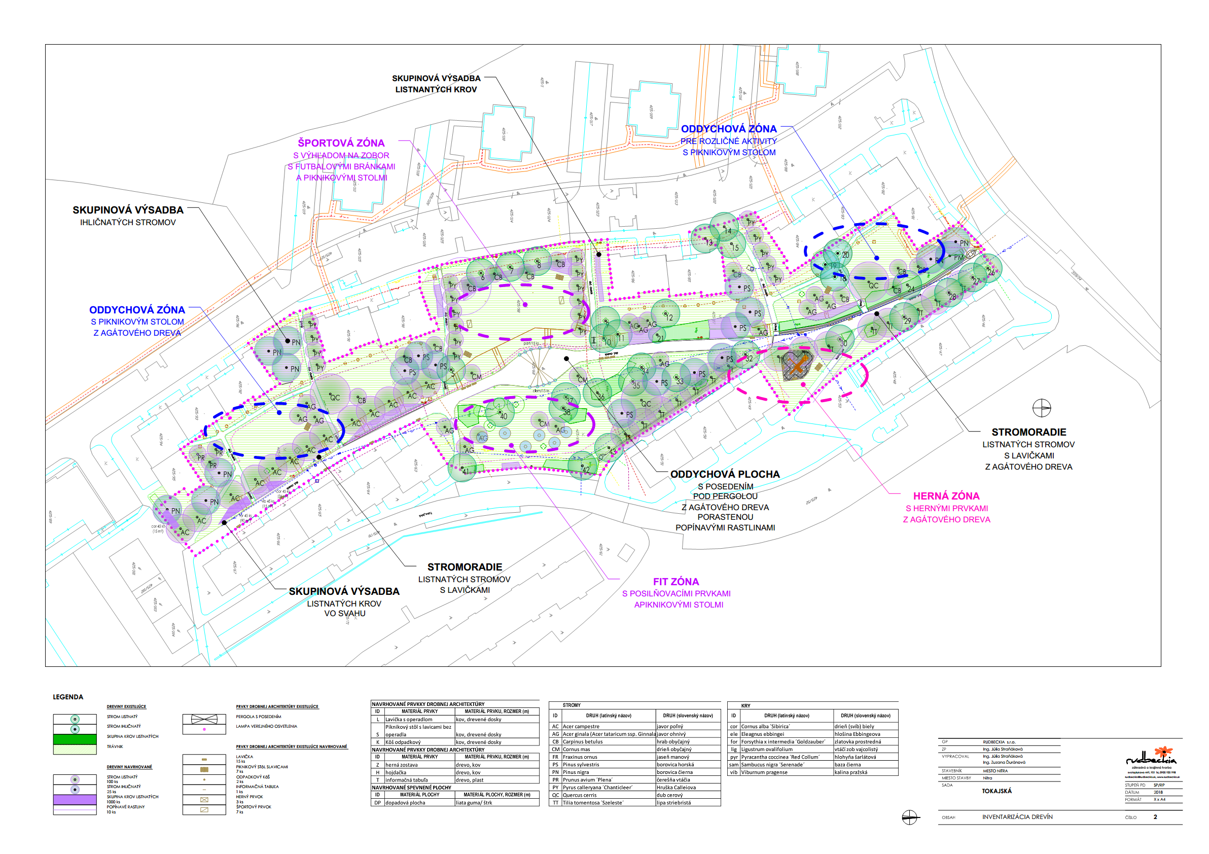
Regeneration of the Inner Yards of the Settlements: Párovce, Diely, Klokočina /2017/

Slide 17
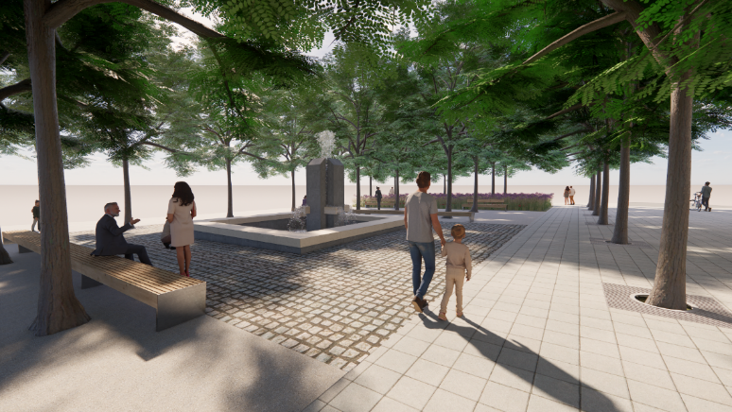
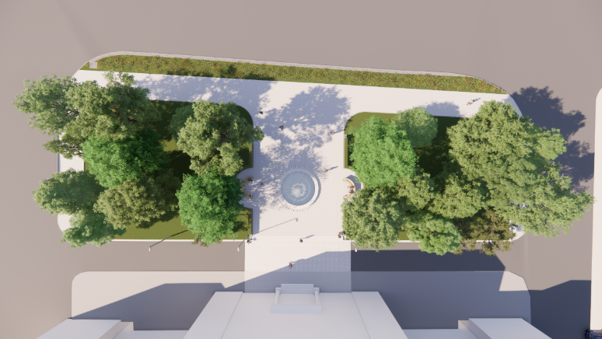
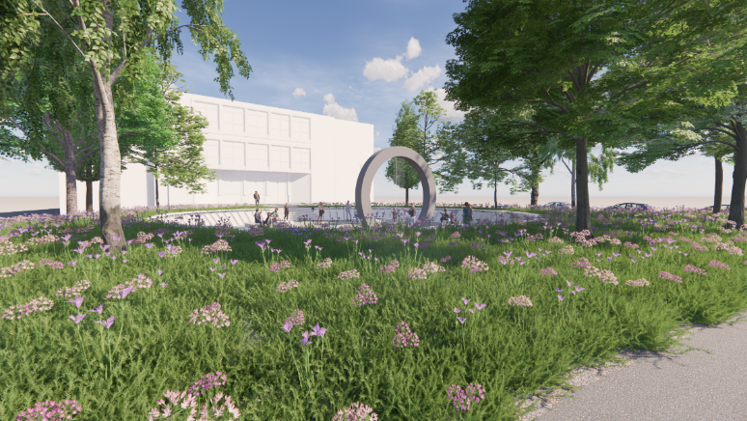
3 CITY FOUNTAINS + POCKET PARKS /2023/
PROVIDING SHADE
RAIN WATER MANAGEMENT
RECONSTRUCTION OF CITY FOUNTAINS
MICROCLIMATE BETTERMENT

Slide 18
ONGOING PROJECTS

Slide 19
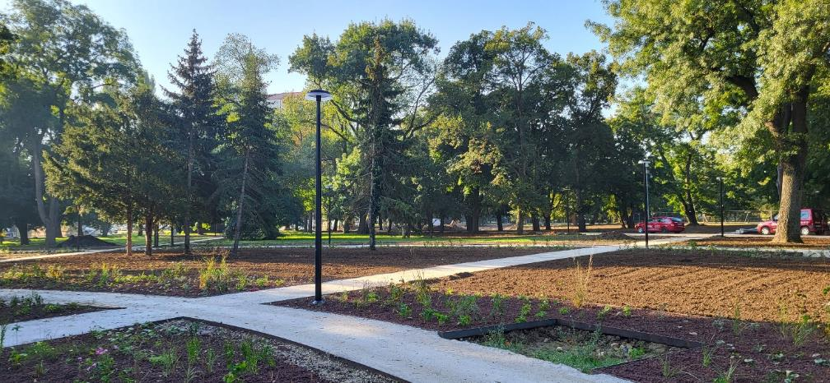
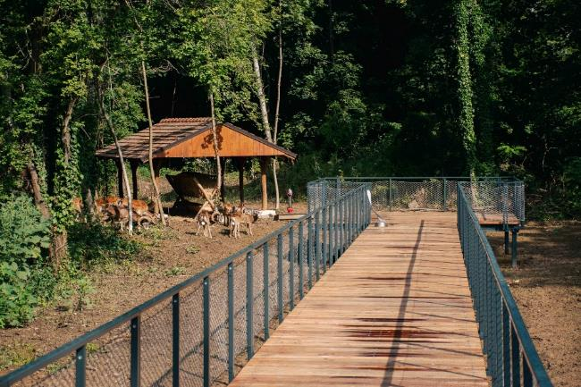
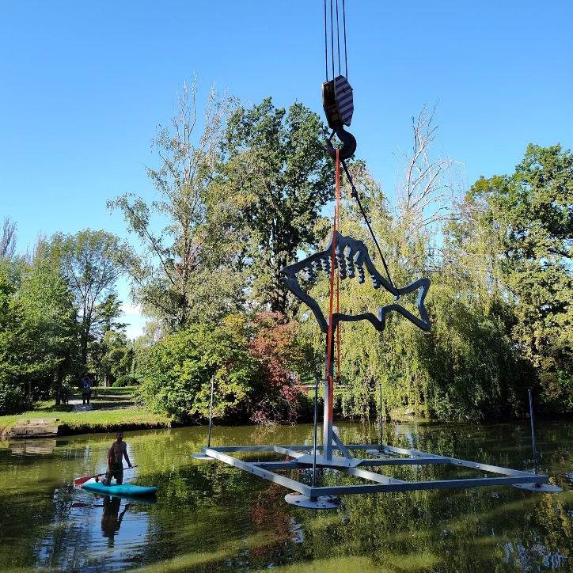
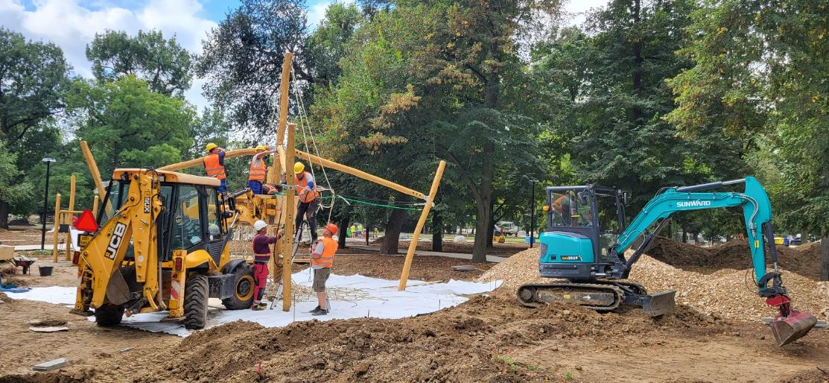
MUNICIPAL PARK /2022 – 2023/

Slide 20
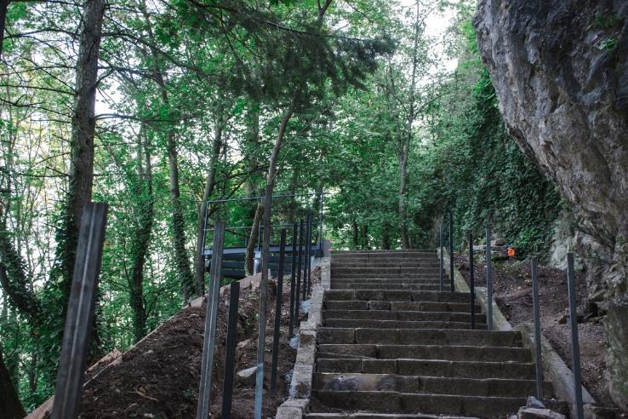
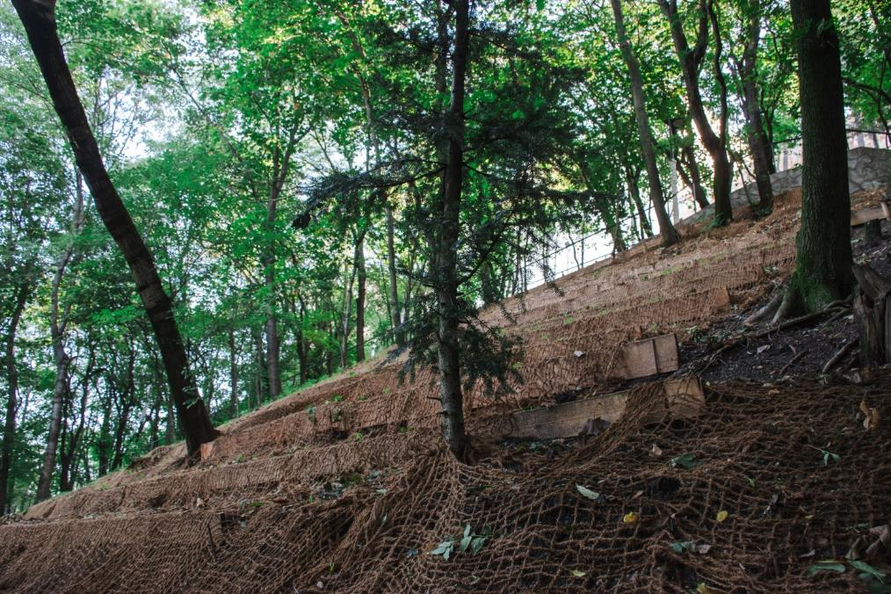
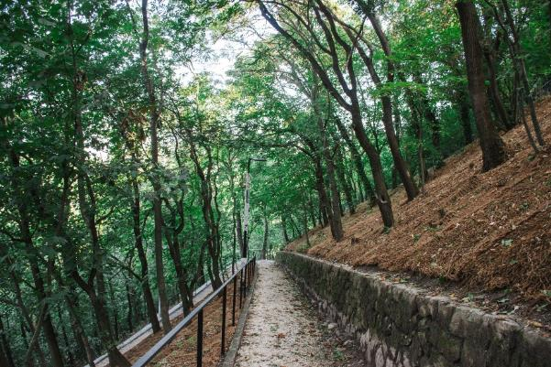
CASTLE HILL – WATER EROSION MITIGATION /2023/
RECONSTRUCTION OF SIDEWALKS, STAIRCASES
PLANTINGS OF GROUND COVERS

Slide 21
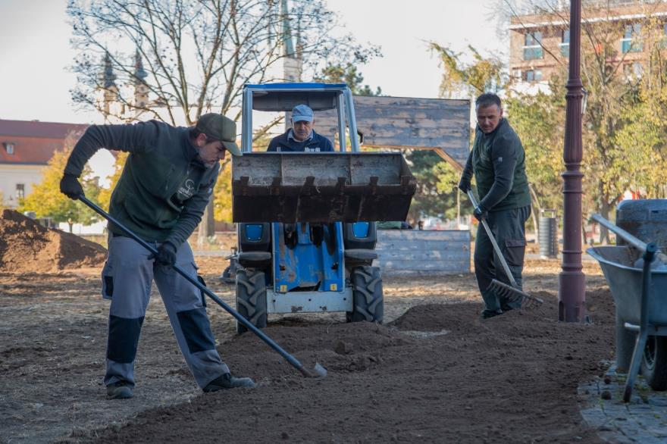
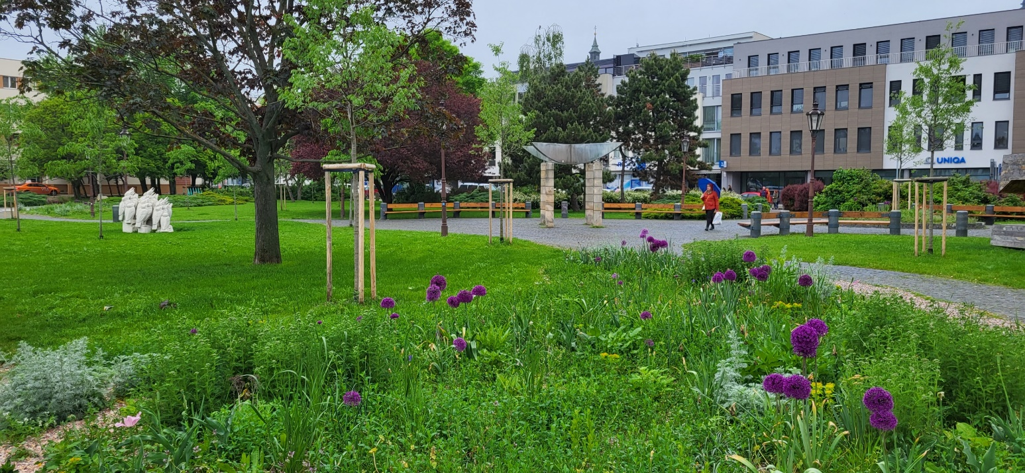
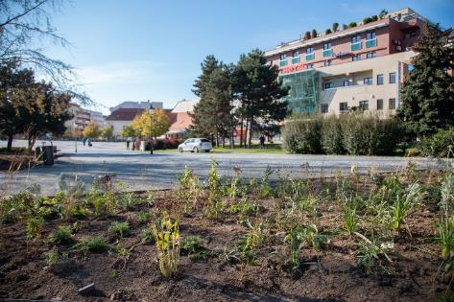
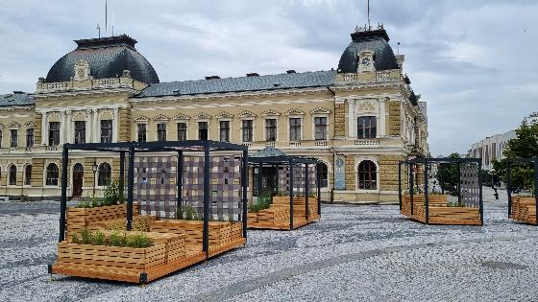
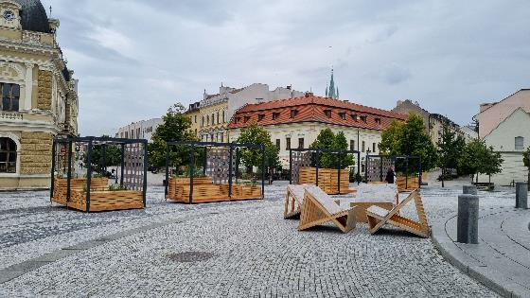
CITY CENTRE POCKET PARK + SHADE PROVIDING MOBILIAR /2021 – 2022/

Slide 22
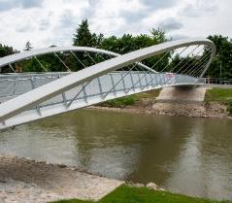
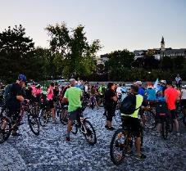
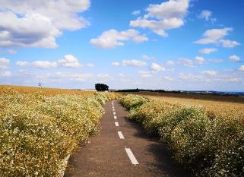
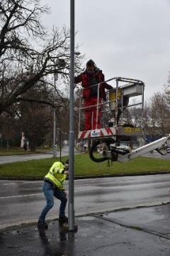
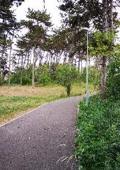
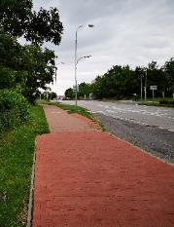
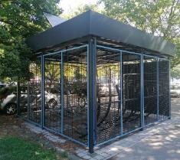

BUILDING THE CYCLING INFRASTRUCTURE /2018 – 2023/
AIR QUALITY MONITORING /2021 - ... /

Slide 23




TREE SAFETY
ARBORISTIC INTERVENTIONS

Slide 24












PLANTING OF NEW TREES – COMPENSATION FOR THE ASANATION OF OLD OR ILL TREES /annually/
FLOWER BEDS – SUPPORTING INFILTRATION OF RAIN WATER

Slide 25



Source: https://nitra.dnes24.sk/galeria/pesiu-zonu-v-nitre-skraslili-nove-stromy-rastu-v-mobilnych-kvetinacoch-foto-101249/fotografia-1?articleId=422042
SMALL GREEN INTERVENTIONS IN THE CITY CENTRE /2022/

Slide 26
PUBLIC INVOLVEMENT 2016 - 2023

Slide 27


Community planning scheme
Environmental issues focus
28 Projects submitted
Online voting
Volunteering

Slide 28




Examples of successful projects
Web application – planting the trees on demand
Municipal compost storages /36/
Art in public spaces
Flower meadows in University Botanical garden

Slide 29



UNIVERSITIES INVOLVEMENT – potential for the „Out of the box“ thinking
SLOVAK TECHNICAL UNIVERSITY – Faculty of Architecture, Bratislava
SLOVAK UNIVERSITY OF AGRICULTURE – Faculty of Horticulture and Landscaping, Nitra
Green Infrastructure
Rain water management
Public spaces Quality
Housing
Services

Slide 30




SPOLKA NGO – PARTICIPATION & PLANNING PROCES – FORMER MILITARY BARRACKS – ZOBOR HILL
Online questionary /1700+ hits/
12+ stakeholders
Workshops, walking tour, interviews

Slide 31
ENVIRONMENTAL DEPARTMENT RESOURCES
13 officers
Broad area of responsibilities /urban greenery, environmental protection of air and water resources, waste management, playgrounds for kids, etc., conceptual work, evaluation of investments, designs, EIA process, etc./
Maintenance of urban greenery – 280ha, 9 contractors, 1.3 mil. € forseen annual budget for 2024 – 2027
Tree safety 150k € annual budget /dendrology + arboristic evaluation included/
New plantings of trees and flowe beds 120k € annual budget
EU&NATIONAL FUNDING /95% OF TOTAL COSTS
Municipal park – 6.7mil € + 800k €
Castle Hill – 850k €
Brezový háj – 380k €
Revitalisation of 3 city fountains + pocket parks 1.2 mil. €

Slide 32

THANK YOU
www.nitra.sk
Tel.: +421 37 65 02 229
lancaric@msunitra.sk

