Slide 1
Virtual Mobility Program On-line Course in Sustainable Development
ERASMUS-EDU-2022-CBHE-STRAND-1
ERASMUS-EDU-2022-CBHE
101083212
ERASMUS-AG-LS
Prepared by: Faculty of Management Herceg Novi / AUB, Montenegro

Slide 2
Sustainable Development Specialization
At the basis of the all definitions of sustainable development today is the one that sustainable development is perceived through three-sided prism interwining ecological, economical and social dimension.
Despite different interpretations in literature, this concept today has central position in considering long-term perspective of survival and progress of menkind.
Sustainability, or sustainable development, is seen as essential prerequisite but also as final aim of efficient organization of numerous human activities.

Slide 3
Sustainable Development Specialization
﻿Specialization - 4 course series
The Sustainable Development Specialization is the ideal choice for curious individuals who enjoy unique learning experiences and innovative teaching approaches. Its style is likely to appeal especially to young, middle-aged and young-at-heart learners.
﻿The specialization is intended for learners interested in engaging in fundamental theories and concepts of sustainable development and applying these to practice. Students will benefit from deepening and refreshing their existing knowledge by means of our specialization.

Slide 4
Sustainable Development Specialization
﻿Participants will learn to understand and analyse:
(1) Concept and basic principles in sustainable development
(2) National and international/EU strategies of sustainable development
(3) Priorities of sustainable development and how to make sustainable development closer?
(4) Green Marketing

Slide 5
Sustainable Development Specialization
﻿This course is completely online, so there’s no need to show up to a classroom in person. You can access your lectures, readings and assignments anytime and anywhere via web or your mobile device.
No background knowledge in sustainable development is required. Anyone interested in learning more about sustainable development is welcome to join the specialization.
Specialization is organised in English language, so all students must have intermediate level of English language (B1 – B2 level).

Slide 6
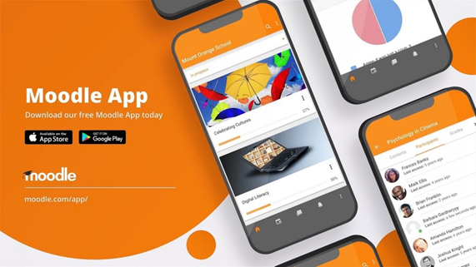
Sustainable Development Specialization
All materials will be posted to Moodle platform.
Teams of students will be formed, comprising of students from different universities and each team will have a mentor assigned to them.
Since the program is project-based, at the end of each topic series, the teams will present their project related to that particular series.
Upon successfully presenting their projects and project evaluation, members of each team will be awarded certain number of ECTS credits.
Duration of the course will last for one semester / 4 months – one month for each topic series.

Slide 7
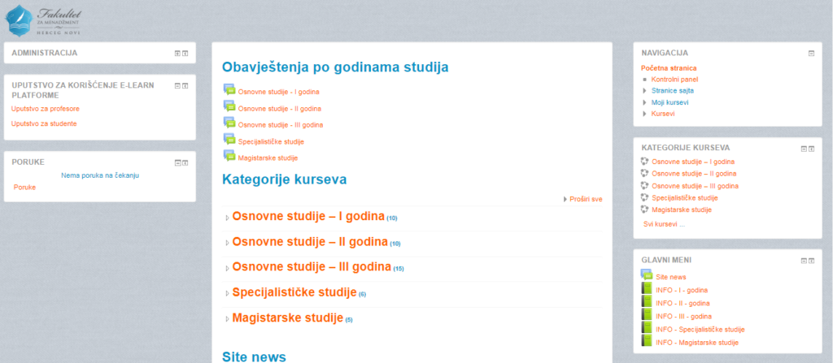
Sustainable Development Specialization
Moodle platform:

Slide 8
Sustainable Development Specialization
Upon completion of Specialization, the students will be able to:
understand idea and concept of sustainable development locally as well as globally;
describe specific theories, concepts and principles of sustainable developemnt;
assess resources and possibilities, formulate strategies necessary for resolving particular problems of sustainable development;
develop principle of critical thinking and compare different approaches, regarding ecological, economical and social dimensions of sustainable development; and
develop communication skills in resolving and presenting problems of sustainable development

Slide 9
Sustainable Development Specialization
With ECTS credit upon completion of each thematic series, the participants will, at the end of four months, receive certificate on completed specialization as well as supplement with detailed description of competences obtained.

Slide 10
Sustainable Development Specialization
We did not inherit this planet from our ancestors, but rather borrow it from our descendants.
Come, join us at our specialized on-line course.

Slide 11
Sustainable Development Specialization
Thank you for the attention ☺

