Slide 1
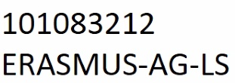
Greening Relevance in Operations in Western-Balkans Tertiary-Education Habitats Work Package 5: COMMUNICATION & EXPLOITATION
Dr.sc. Nermin PALIĆ
Doc.dr. Mirzo SELIMIĆ
University College „CEPS-Center for Business Studies” Kiseljak
Wednesday, 29 March 2023.

Slide 2
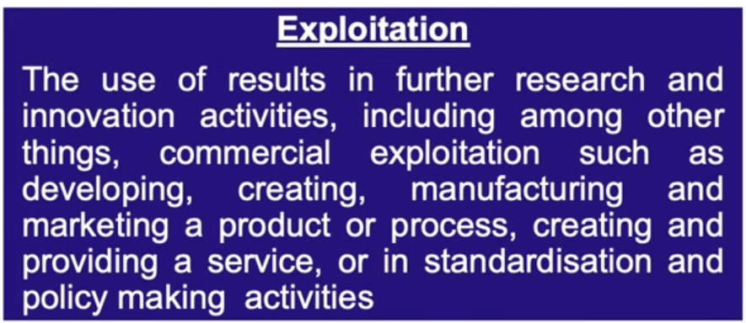
DEFINITIONS
„If it wasn't seen, it's like it didn't even happen”
„Information is useless if it is not applied to something important”
COMMUNICATION
&
EXPLOITATION

Slide 4
Work Package 5
This work package comprises eight tasks devised with the intention of:
a) communicating project activities and interventions through joint cooperation and collaboration,
b) disseminating project results and outcomes to project beneficiaries and all other direct and indirect stakeholders;
c) exploiting project results, i.e., using them for further environmental awareness campaigns or to develop further processes and/or products, and
d) securing sustainability of project results and outcomes.
This is not an intervention package as its devised activities are meant to imbue all work packages and last during the whole project cycle.
Duration:
M1 – M36

Slide 5
Specific objectives to which this work package is linked:
SO1) To make higher education and research in the Western Balkans more environmentally conscious;
SO2) To introduce green education methodologies and practices in four partner higher education institutions.

Slide 6
T5.1 – Maintenance and promotion of Towards
green university website
Project website will be regularly updated with project-related information (communication and dissemination activities, latest achievements, results and milestones, etc.). Information will be uploaded by designated administrators (2 with full access to website parameters) of the project Dissemination team. Project website will contain suitable Erasmus + Programme logo, as well as other required funding and ownership symbols. Links will be created towards individual partner´s websites and the content will be presented in English and/or local partner languages (Bosnian and Montenegrin). Data will be uploaded whenever opportunity presents itself, on average 3 per month.

Slide 7
T5.2 – Creation of policy brief Towards green university
A policy brief Towards green university is to be led by Herzegovina University and University of Applied Sciences Weihenstephan-Triesdorf and developed jointly by the partnership. It should comprise the summary of the main project topic, which is the creation of green universities as well as recommendations, best options and justified reasons on a path towards greening one´s universities.
It is intended for all those who are interested in creating a policy framework for prospective green universities, green communities and green transition in general.
Target groups are: autonomous higher education bodies, ministries, government advisors, civil servants, etc.
Policy brief aims to secure the sustainability of the project idea by recommending it to a wider community.
It is planned to distribute the policy brief among minimum 200 recipients.

Slide 8
T5.3 – Adoption of ‘’Towards green university’’
strategy
During M? of project implementation four strategy documents devised by four target HEIs in collaboration with the partnership will be adopted by four University Senates of target HEIs. Strategies will consequently be incorporated in four statutes of target HEIs thus making the strategy the official policy of the aforementioned universities at hand.

Slide 9
T5.4 – Promotion of policy brief ‘’Towards green
university’’ across HE and the society
The policy brief Towards green university will be promoted though various communication and dissemination activities: project website, individual HEIs websites and social network profiles, all available local and national media in the four target countries, and across Western Balkans, during the final promotional conference, in the newsletter, etc.

Slide 10
T5.5 – Publication of annual e-newsletter
‘’Towards green university’’
Three annual newsletters will be published in the course of the project, and they will continue to be published even after the project lifetime. The newsletter will contain relevant and principal information relating to the project and its achievements. The e-newsletter will be 4-8 pages long and it will contain inputs and contributions from all partner institutions. The e-newsletter will be available in English, Bosnian and Montenegrin. It will be published on the project website and individual websites of all partner institutions.

Slide 11
T5.6 – Local institutional training sessions on
recycling culture, green energy sources, infrastructure
Training sessions are intended for all stakeholders (teaching, administrative, technical and management staff, student organizations members) at four target HEIs who have the opportunity to further share the knowledge and skills, organize campaigns and animate wider community to participate in the green transition conceived by the GROWTH. Twelve training session in total have been planned at four target universities and they will include 12 participants each. It is expected that 30% will be female participants.

Slide 12
T5.7 – Organization of green university
innovation hackathons competitions
Four green innovation hackathons have been planned, one at each target HEI. It is expected that there will be 60 participants in total. They will gather around previously jointly devised green goals and ideas with the aim of creating a solution/product the character of which will be environmentally friendly, which will testify to the green university orientation and which will be usable in the refurnished green university habitat. Hackathons have the character of competitions, whereby the best idea will be rewarded and promoted within the project dissemination campaign and beyond.

Slide 13
T5.8 – Final promotional conferences ‘’Towards green university’’
During M36, partner HEIs will host the national dissemination conferences that will have a hybrid form. Two such conferences are planned by the GROWTH proposal and they are planned to gather minimum 120 participants (60 in the physical environment, and at least 60 more in the virtual environment). The conferences will serve to showcase and promote project results relating to newly established green practices at four target universities in Western Balkans. By displaying project achievements, conferences will contribute to further raising awareness of climate change, share examples of good practice, pinpoint the barriers and limitations and provide recommendations for future actions.
Presenters will be selected from various fields, social and cultural groups: teaching and non-teaching staff, students, university heads and managers, representatives of local self- government and other policy makers, representatives of different groups with fewer opportunities (female participants, persons with physical disabilities, persons from remote/inaccessible regions). They will be invited through and open call, and participation of the aforementioned persons with fewer opportunities among speakers and presenters will be favoured.

Slide 14
Milestones and deliverables (outputs/outcomes)
Milestones are control points in the project that help to chart progress. Means of verification are how you intend to prove that a milestone has been reached.
Deliverables are project outputs which are submitted to show project progress (any format).

Slide 15
Milestones

Slide 16
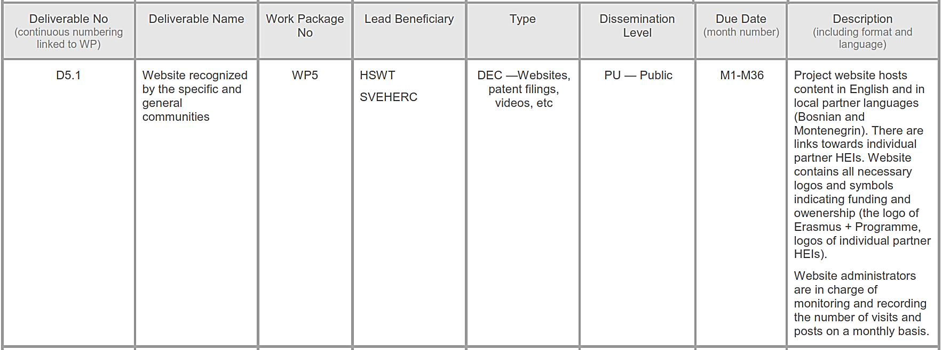
Deliverables

Slide 17
Deliverables

Slide 18
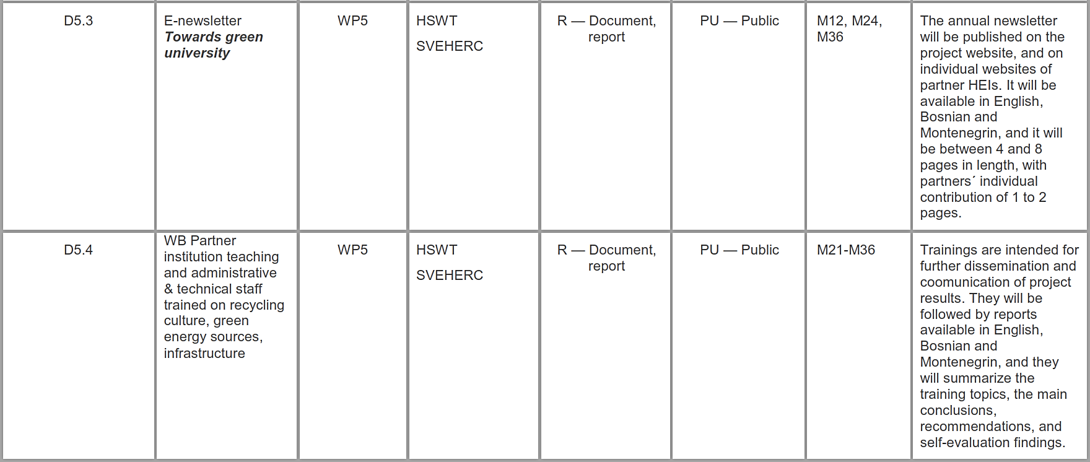
Deliverables

Slide 19
Deliverables

Slide 20
Deliverables

