Slide 1
KICK-OFF MEETING
ERASMUS-EDU-2022-CBHE-STRAND-1
Project Number: 101083212
Aleksandar Vasić
Ivan Tomić
Funded by the European Union. Views and opinions expressed are however those of the author(s) only and do not necessarily reflect those of the European Union or the European Education and Culture Executive Agency (EACEA). Neither the European Union nor EACEA can be held responsible for them.
University Bijeljina, March 29-30, 2023

Slide 2
WP3 – GREEN TRANSITION IN TEACHING, LEARNING AND RESEARCH
This package comprises four activities leading to the introduction of necessary green methodologies in the process of higher education.
It introduces methods and approaches which result in raising environmental awareness and informing human action towards innovative and environmentally friendly forms of behavior.

Slide 3
The package WP3 is intended for introducing green methodologies in higher education institutions in order to make the education process environmentally friendly regardless of the scientific field and/or domain. The majority of the so-called green approaches nowadays involve the use of modern technology.
However, green methodologies imply so much more and activities planned under this package will serve to introduce the teaching staff to innovative and creative, yet environmentally friendly teaching approaches.

Slide 4
A very important part of higher education process is staff and student mobility, i.e., the much-needed exchange of skills, knowledge, experiences, customs and practices through international cooperation and communication.
One of the solutions in this moment is virtual mobility which also needs to be regulated by certain conditions, policies and regulations.
specific objective

Slide 5
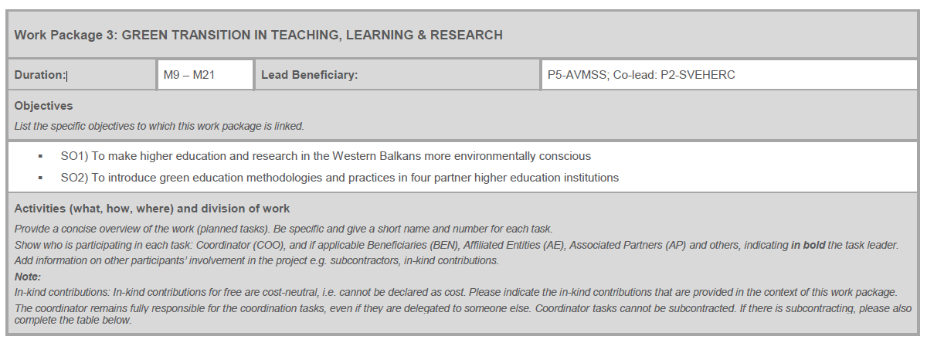

Slide 6
Task No | Task Name | Description
T3.1 | Introduction seminar for teaching staff on green teaching and learning classrooms and methodologies | In the course of M9 a two-day virtual seminar will be organised for the teaching staff, on the topic of green teaching and learning classrooms and methodologies. The teaching staff will be introduced to the methodologies and practices which are aimed at exerting a powerful influence on students in regard to environmental conservation. These methodologies are applied for the purpose of developing an ethical commitment to environmental conservation in students through valuating environmental sustainability. These methodologies comprise the why and how of raising environmental awareness: how to carefully and systematically develop environmental beliefs and values and translate them into environmentally-friendly behaviour. The stated methodologies are grounded in project-based learning and hands-on student activities. The seminar is planned to last for 2 days (5 hours per day). It is intended for 36 participants in total, and it is expected that at least 30% will be women.

Slide 7
Task No | Task Name | Description
T3.2 | Creation of video tutorial for teachers on the creation of environmentally friendly teaching forms | After the first day of seminar, the WP3 team led by SUA and AVMSS staff will start creating video tutorial for teachers on the creation of environmentally friendly teaching form. The video tutorials will be audio-visual instructions on key methods and techniques applied to create environmentally friendly teaching forms. All materials will be in English, and the videos will have subtitles in Bosnian and Montenegrin languages. The videos will be available at project website and partner HEIs websites.

Slide 8
Task No | Task Name | Description
T3.3 | Study visit | This study visit will be organized and hosted by AVMSS from Serbia, and assisted by SUA from Slovakia. Sixteen staff members will learn on-site about green teaching and learning classrooms and methodologies. The host AVMSS is a higher education institution whose strength is development of teaching and learning methodologies based on project approach and integrative learning which are in this case pivotal for embracing green practices. Study visit will take place in M? and it will gather 16 participants (4 per target partner university). It is expected that 30% of participants will be women.

Slide 9
Task No | Task Name | Description
T 3.4 | Development of green university innovation hackathons | Hackathons are relatively new events in the Western Balkan countries and four target universities will need to develop guidelines for organizing these complex but innovative events. These guidelines will be developed through one organized online meeting in M21. The meeting is to last for 5 hours and it will include representatives of all partner institutions (at least two per partner, and at least 30% female participants). Participants will decide on the steps as to how to organize hackathons: setting the goal, date, place and time, marketing the event in a green way, recruiting the sponsors, devising registration forms, branding winning ideas, etc.

Slide 10
Milestone No | Milestone Name | Description | Due Date (month number) | Means of Verification
MS3 | Green university innovation hackathons prepared for implementation | Preparing implementation of an event such as hackathon implies a detailed action plan foreseeing every step in a successful realization, from the initial idea to the final product and finalized event. | M21 | Hackathons organization guidelines, comprising an action plan.

Slide 11
Deliverable No | Deliverable Name | Type | Dissemination Level | Due Date | Description
D3.1 | 2.1) Management, teaching, adm2.8) in. & technical staff improved knowledge on climate-neutral universities. | R — Document, report | PU — Public | M9 | The green teaching and learning training will be depicted through a report which will summarize the entire flow and key conclusions of the seminar for the teaching staff. It will be available in English and uploaded to virtual project drive

Slide 12
Deliverable No | Deliverable Name | Type | Dissemination Level | Due Date | Description (including format and language)
D3.2 | Video tutorial | DEC —Websites, patent filings, videos, etc | PU — Public | M12 | The video tutorial for teachers covers the topic of how to create the environmentally friendly teaching forms and approach the topic of green practices from the standpoint of innovative and environmentally friendly methodologies. The video tutorial will be available in English with subtitles in Bosnian and Montengerin languages. The video will be available as open access resource on the project website.

Slide 13
Deliverable No | Deliverable Name | Work Package No | Dissemination Level | Due Date | Description (including format and language)
D3.3 | Study visit and learning about student hackathons carried out | WP3 | PU — Public | M21 | Study visit will be recorded and depicted through a report which will summarize activities performed during the study visit to Serbia, main conclusions and recommendations, as well as participants´ evaluation of the project activity. Furthermore, the report will comprise precise data about the place, time, number of participants and their exact personal details, as well as the agenda of thevisit. It will be available in English and uploaded to virtual project drive.

Slide 14
Deliverable No | Deliverable Name | Work Package No | Dissemination Level | Due Date | Description (including format and language)
D3.4 | Green university innovation hackathons prepared for implementation | R — Document, report | PU — Public | M15 | In preparing the hackathons the consortium will draw guidelines as a set of actions and recommendations for teaching staff, helping them to organize and implement green university innovation hackathons. This document will be produced in an e-form and published in English and Bosnian and Montenegrin. It will be available on the project website.

Slide 15
Thank you for your attention!

